Slide 1
EEDG/CE6302 Lab 8 Introduction to UART Communication Protocol

Slide 2
UART Standard
Universal asynchronous receiver/transmitter – an approach to serial communication between two devices in which neither device shares a common clock.
Each device only uses lines for data.
Has a predefined protocol for how data is framed, how data packets start and stop, and how the receiver oversamples the incoming data to recover the information sent.

Slide 3
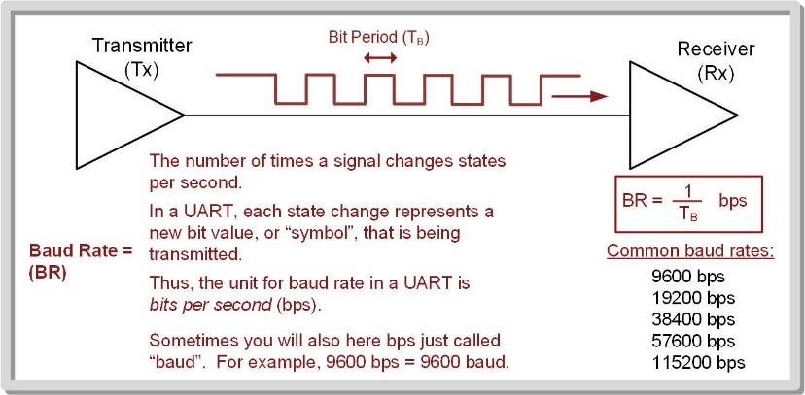
Buad Rate (BR)
It is the common data rate between Tx and Rx; the fastest rate at which the data line changes states.
The baud rate and bit period (TB) are related by BR = 1/TB.
Baud rate must be set manually in both the Tx and Rx prior to data transmission (typical range is 9600 to 115200 baud).

Slide 4
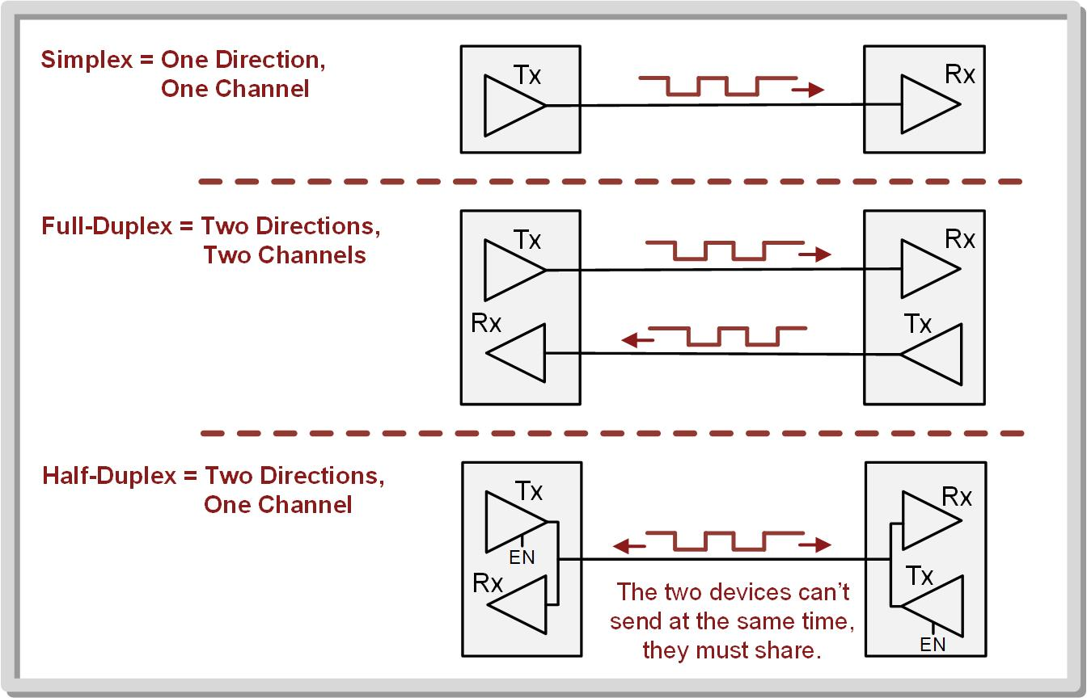
Link – when two devices are connected together to transfer information.

Slide 5
Framing
Used to describe how the bits are arranged in the UART serial bit sequence.
Start bit – initial symbol
To start a data transmission, the Tx drives the line LOW and holds it there for one T_{B}.
The data word is transmitted bit-by-bit, typically starting with the LSB.
Stop bit – last symbol
After the bits have been transmitted, the Tx drives the line HIGH for one TB to represent the end of the sequence.

Slide 6
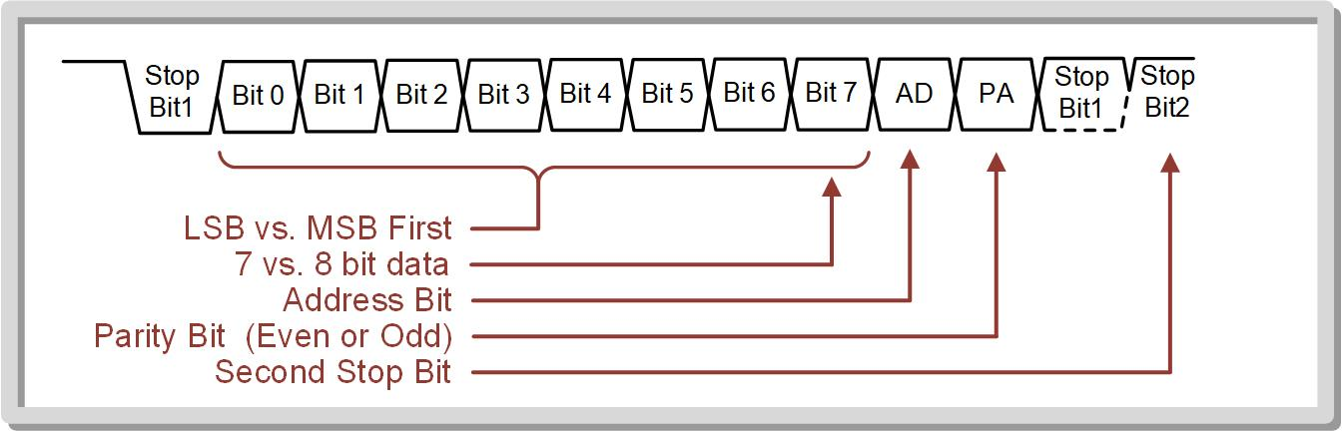
The most common options that are configurable on the MSP432 are swapping the order in which the bits are sent, changing the data size between 7-bits and 8-bits, adding on address bit (AD), adding a parity bit (PA), and adding a second stop bit.

Slide 7
When using a transmit address, two frames are sent, one for data and one for address.
The AD bit signifies whether the next frame is the address or data.
The addition of a second stop bit can be used to provide extra time between packets when running at higher baud rates in order to make the link more reliable.
Parity bit – used to detect transmission errors.
Even parity – the transmitter counts the number of 1’s in the data word and if the count is odd, it asserts the parity bit.
Odd parity – the transmitter counts the number of 1’s in the data word and if the count is even, it asserts the parity bit.

Slide 8
How does the receiver determine what logic is sent if it doesn’t have a clock?
Oversampling – using a receiver clock that is faster than the transmitter clock.
The receiver samples the incoming signal 16 times within each bit period. This provides a higher level of accuracy in determining the logic level of each data bit.
In 16x oversampling, if at least 10 out of 16 samples are high, the data bit is considered to be logic high. This approach helps to reduce the impact of noise and jitter in the received signal.
The MSP432 UART module automatically takes care of oversampling for you when you configure it

Slide 9
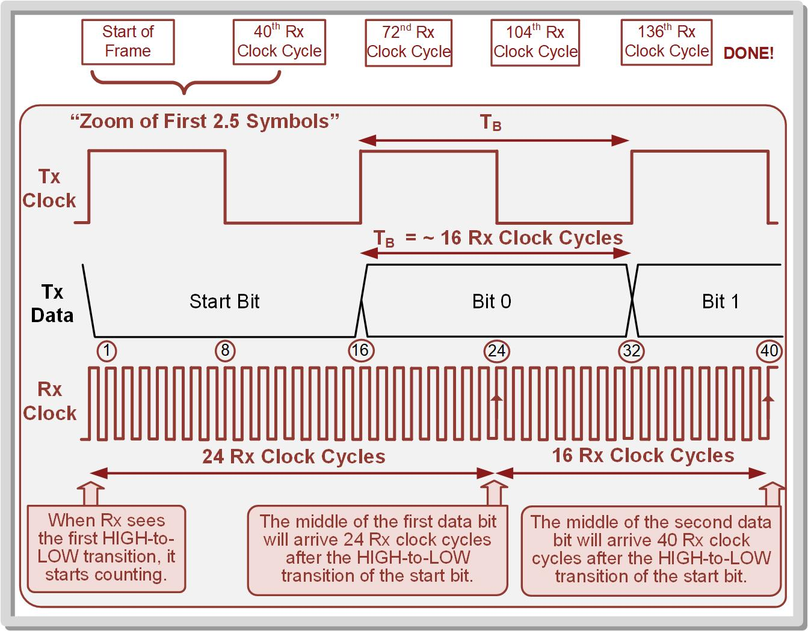

Slide 10
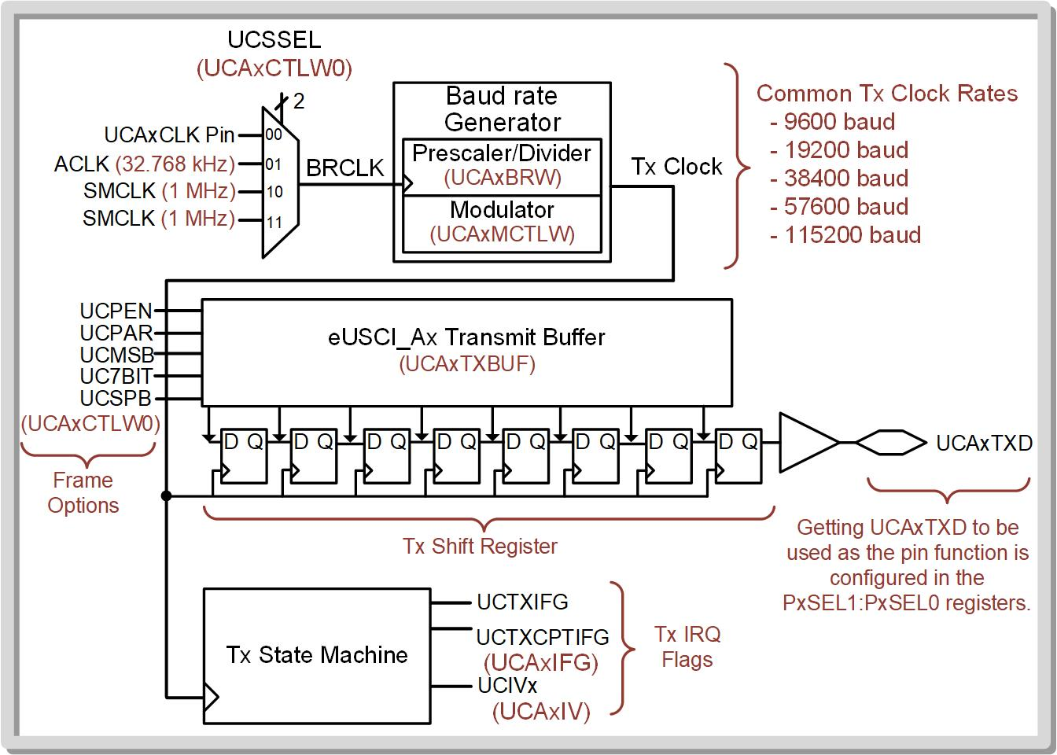
UART TRANSMISSION
The MSP432P401R contains four eUSCIs that support UARTs, eUSCI_A0, eUSCI_A1, eUSCI_A2 and eUSCI_A3.

Slide 11
Steps to Configure the UART Peripheral:
Step 1: Set the UCSWRST bit in the UCAxCTLW0 configuration register to put the eUSCI_Ax peripheral into reset. Note that the default value for UCSWRST = 1 on system power-on or system reset, so the system is initially in software reset.
Step 2: Initialize all eUSCI_Ax configuration registers.
Step 3: Configure ports.
Step 4: Clear UCSWRST to take the eUSCI_Ax peripheral out of reset.
Step 5: Enable interrupts (optional) using the UCRXIE or UCTXIE bits int eh UCAxIE configuration register.

Slide 12
Different registers on MSP432
There are various registers that are used to configure and control the behavior of the communication interface.
eUSCI_Ax Control Word 0 (UCAxCTLW0)
eUSCI_Ax Control Word 1 (UCAxCTLW1)
eUSCI_Ax Baud Rate Control Word (UCAxBRW)
eUSCI_Ax Modulation Control Word (UCAxMCTLW)
eUSCI_Ax Status (UCAxSTATW)
eUSCI_Ax Receive Buffer (UCAxRXBUF)
eUSCI_Ax Transmit Buffer (UCAxTXBUF)
eUSCI_Ax Auto Baud Rate Control (UCAxABCTL)
eUSCI_Ax IrDA Control (UCAxIRCTL)
eUSCI_Ax Interrupt Enable (UCAxIE)
eUSCI_Ax Interrupt Flag (UCAxIFG)
eUSCI_Ax Interrupt Vector (UCAxIV)

Slide 13
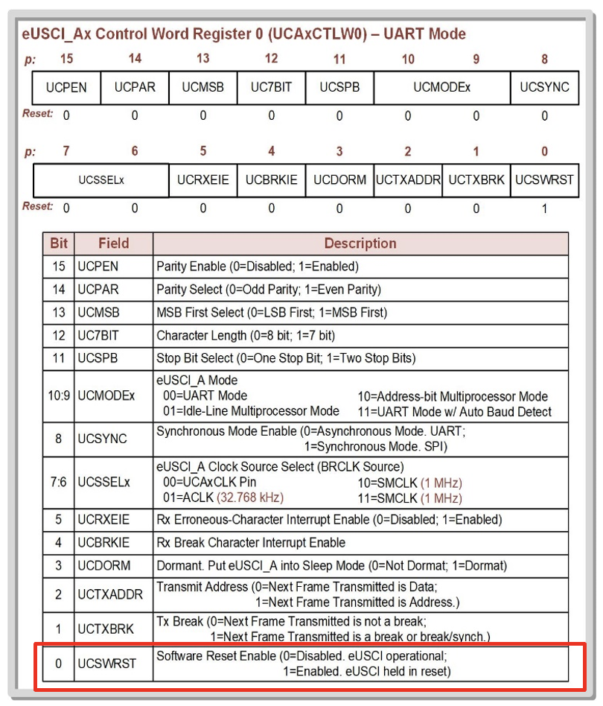
The UCAxCTLW0 register has a LOT of our settings.
First, let’s consider what the default settings out of reset are:
The UCSWRST bit is where we enable/disable the UART.
We need to put into Reset to configure the UART.
Note we “enable” a reset with UCSWRST=1We can choose our clock source using the UCSSELx bits.
We usually use ACLK or SMCLK.

Slide 14
Configuring Pins
EUSCI_Ax | PIN | UART | P1SEL1:0 to select eUSCI
EUSCI_A0 | P1.2 | RX | P1SEL1.2=0 P1SEL0.2=1
 | P1.3 | TX | P1SEL1.3=0 P1SEL0.2=1
EUSCI_A1 | P2.2 | RX | P2SEL1.2=0 P2SEL0.2=1
 | P2.3 | TX | P2SEL1.3=0 P2SEL0.2=1
EUSCI_A2 | P3.2 | RX | P3SEL1.2=0 P3SEL0.2=1
 | P3.3 | TX | P3SEL1.3=0 P3SEL0.2=1
EUSCI_A3 | P9.6 | RX | P9SEL1.6=0 P9SEL0.6=1
 | P9.7 | TX | P9SEL1.7=0 P9SEL0.7=1
To configure the Tx and Rx ports,
use the PxSEL1 and PxSEL0
configuration registers.

Slide 15
Once taken out of software reset, the eUSCI_Ax module is enabled and will wait in an idle state until information is ready to be transmitted.
A Tx is initiated by writing a byte to the eUSCI_Ax Transmit Buffer (UCAxTXBUF).
The data in UCAxTXBUF is moved into the Tx shift register and the baud rate generator beings producing clocks.
The UCTXIFG (in UCAxIFG) flag provides the status of the transmission.
When UCTXIFG = 0, data is being shifted out and new data should not be written to the Tx buffer.
When UCTXIFG = 1, new data can be written to the Tx buffer

Slide 16
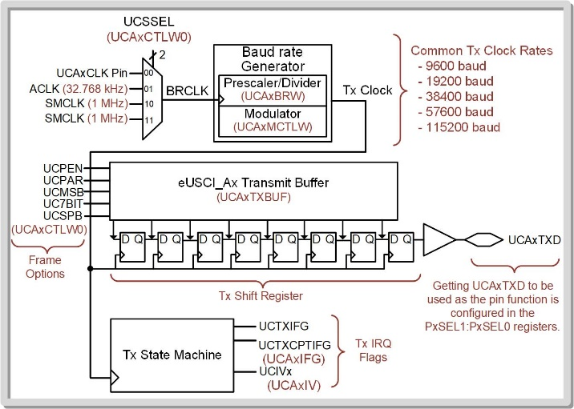
Setting up the Baud rate
The eUSCI_Ax peripheral has a baud rate generation circuit that can produce standard baud rates from nonstandard clock sources such as SMCLK (1MHz) and ACLK (32.768kHz).
The baud rate is set using two configuration registers, the eUSCI_Ax Baud Rate Control Word (UCAxBRW) and eUSCI_Ax Modulation Control Word (UCAxMCTLW) registers.

Slide 17
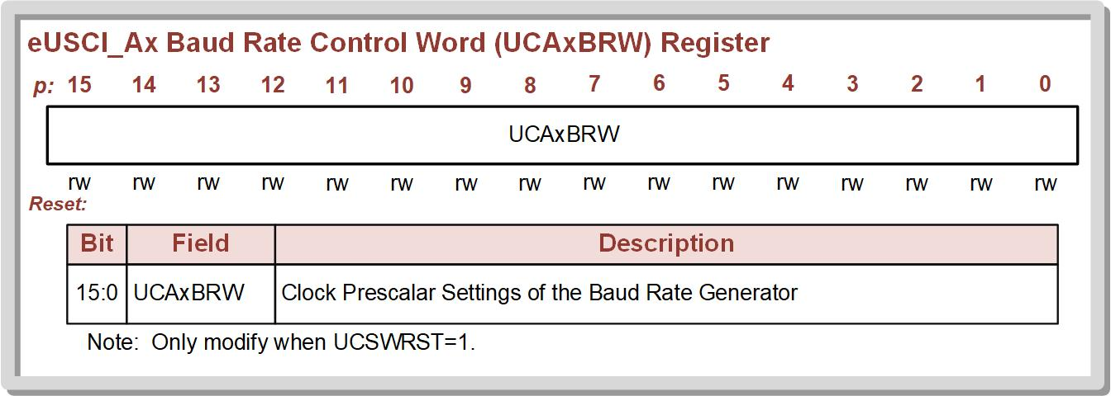
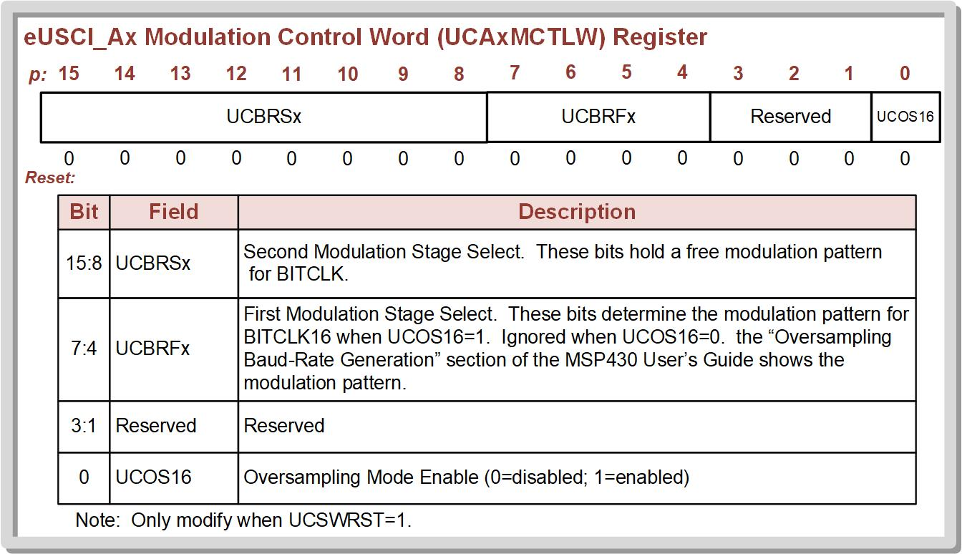

Slide 18
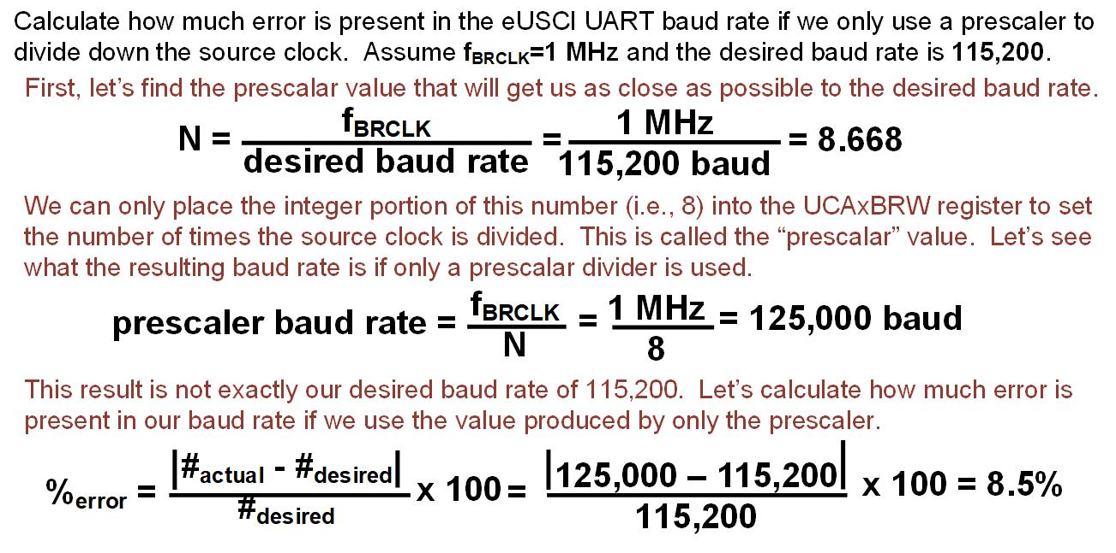
Calculating eUSCI Prescalar Division

Slide 19
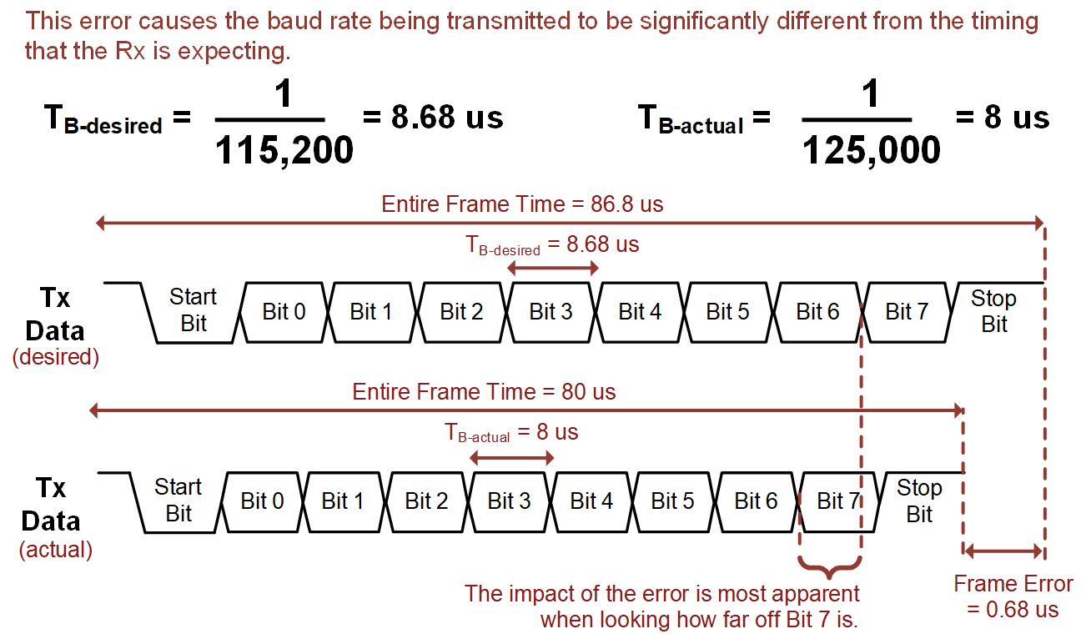
Calculating error in Prescalar Division

Slide 20
Modulation to reduce Errors
Modulation circuits dynamically add and subtract BRCLK periods to the baud rate clock that drives the shift register.
By adding small amounts of time from the BRCLK clock period to the baud rate clock, the timing error can be reduced.
In low frequency mode, the baud rate generator uses the second modulation stage to create the desired baud rate.

Slide 21
Low frequency baud rate generation – used for baud rates that are less than or equal to 1/3 of BRCLK while the oversampling baud rate generation is used for higher ratios.
The UCSO16 bit in the UCAxMCTLW register controls the modulation mode with UCSO16 = 0 being for low frequency (default) and UCSO16 = 1 being for oversampling mode.
In oversampling baud rate mode, both the first and second modulation stages are used to reduce this timing error.
The first modulation stage is configured using the UCBRFx bits within the UCAxMCTLW register.

Slide 22
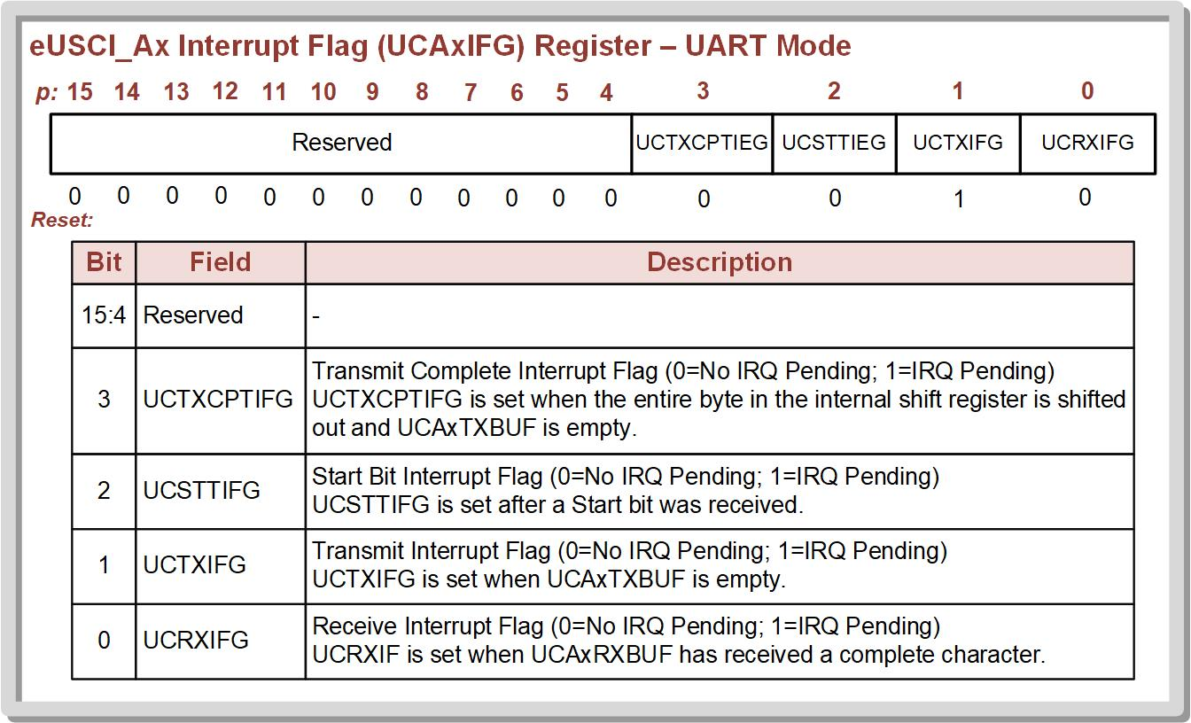
Using Tx IRQs to Control UART Transmission
The eUSCI UART contains a variety of flags that aid in monitoring the status of the link.
These flags can also trigger IRQs.

Slide 23
Transmit Interrupt (UCTXIFG):
Flag is cleared when the Tx buffer data is written to.
Flag is set when the Tx buffer data has been moved to the shift register and the buffer is empty.
Only indicates that the Tx buffer is empty, not that the last character has been fully shifted out.

Slide 24
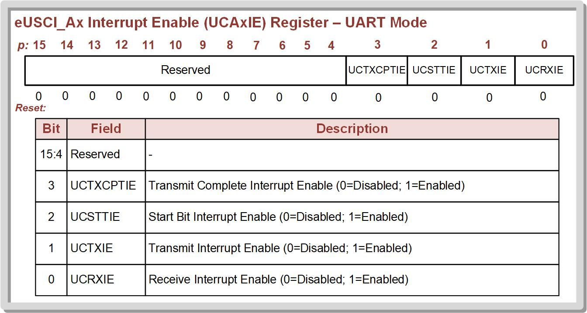

Slide 25
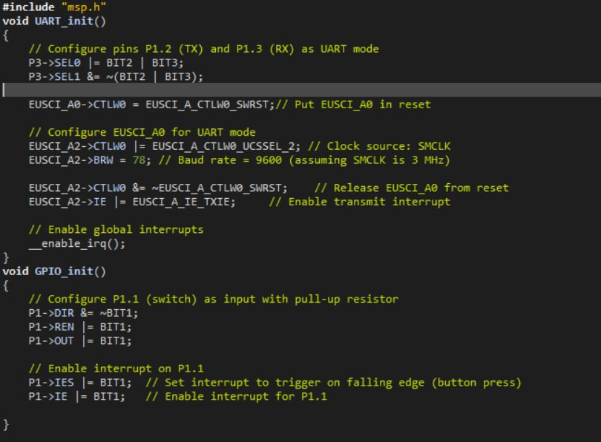
Sending a byte upon pressing switch

Slide 26
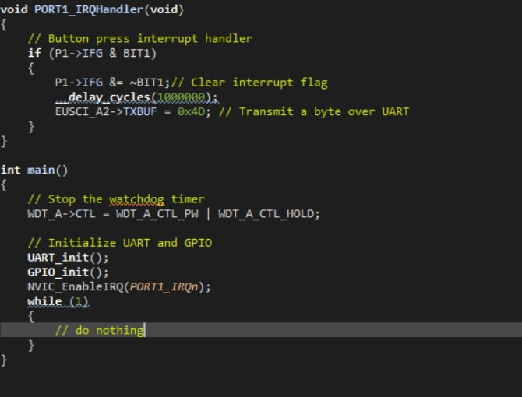
When Switch S1 is pressed, it triggers
Port1_IRQHandler interrupt
Here we are enabling the local interrupt

Slide 27
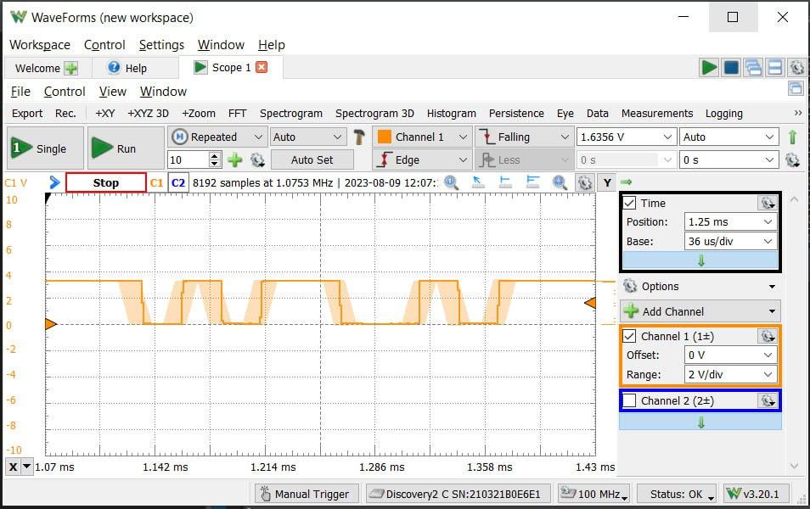
Save and debug your program, Run the program.
Note that the received
Byte is 0b10110010.
MSP432 Sends LSB first
Putting in this order of
MSB first we get
0b01001101=0x4D
Start 1 0 1 1 0 0 1 0
bit

Slide 28
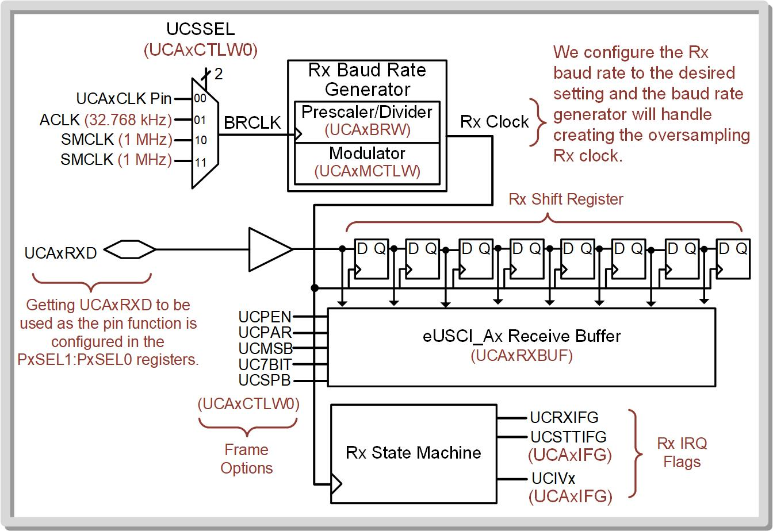
UART Receive
The same clock generator is used for both the Tx and Rx circuits and is configured using the UCAxBRW and UCAxMCTLW registers.
The Rx baud rate generator is configured with the desired baud rate, and the system automatically handles creating the oversampling clock for the Rx shift register.

Slide 29
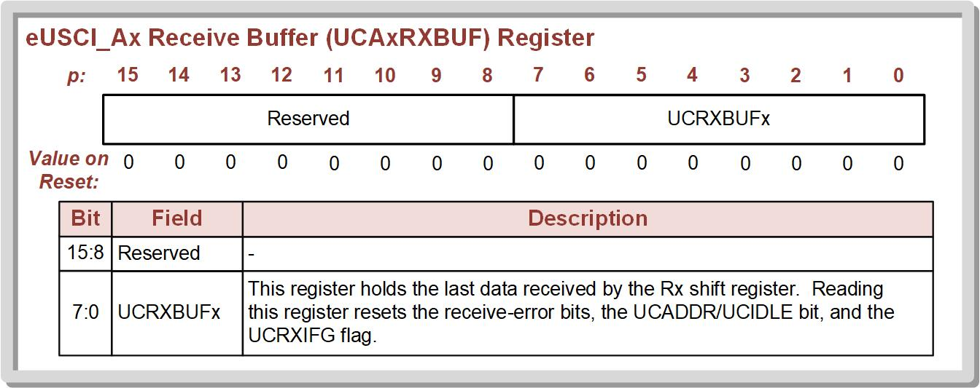
The Rx system is very similar to the Tx system in that it contains a shift register that receives the serial data.
Once the frame has been received, it is put into the Rx receiver buffer (UCAxRXBUF).

Slide 30
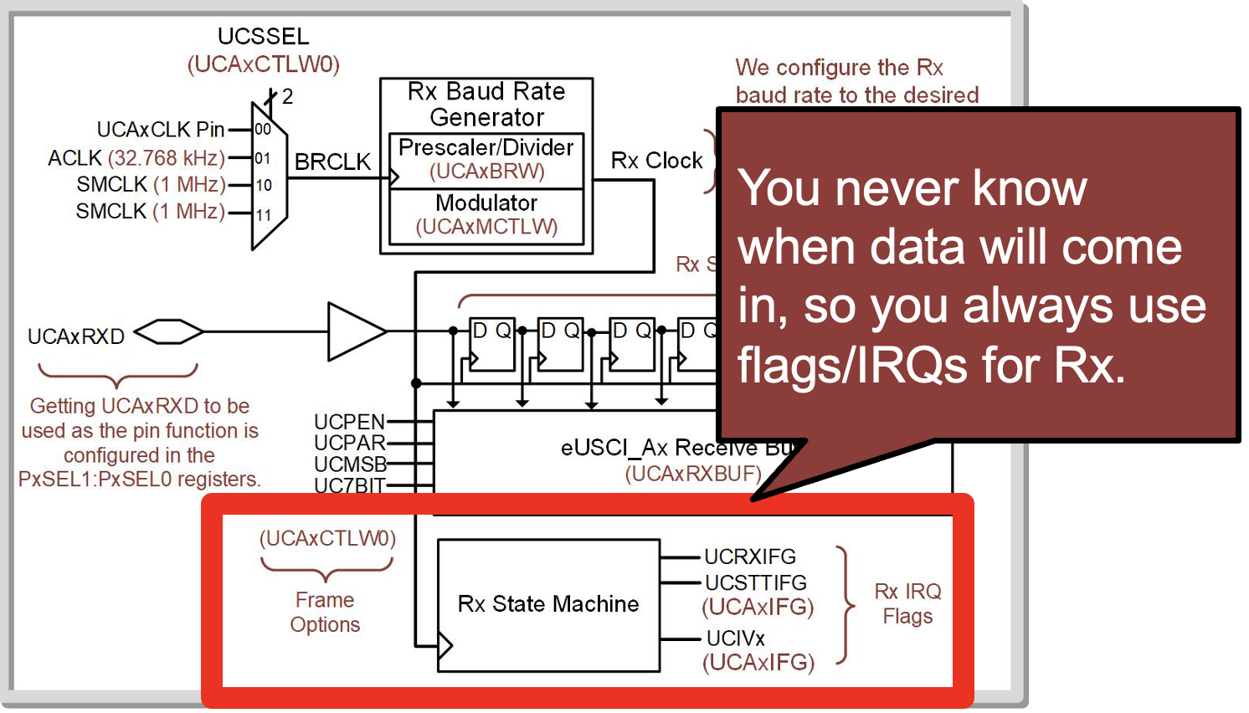

Slide 31


Receive interrupt (UCRXIFG):
Triggers when a new character has been received and the data is available in the Rx buffer.
Cleared when the Rx buffer is read.
UCRXIFG has its own flag and local IRQ enable.

Slide 32
Start bit interrupt (UCSTTIFG)
Triggers when the system sees a HIGH-to-LOW transition on the Rx pin indicating a new frame is being received.
UCSTTIFG has its own flag and local IRQ enable.

Slide 33
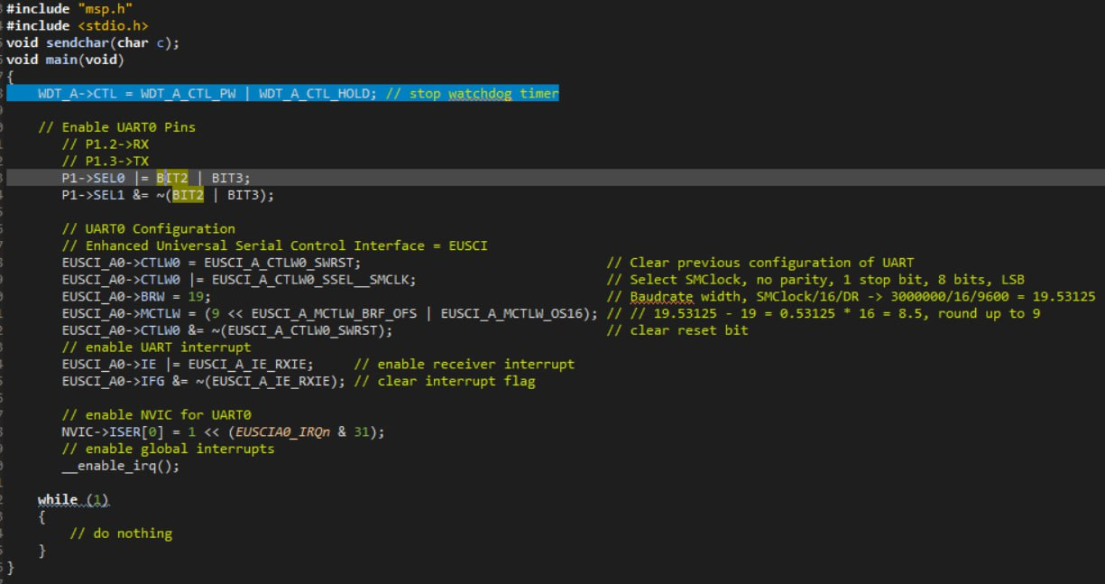
Receiving Characters and printing them

Slide 34
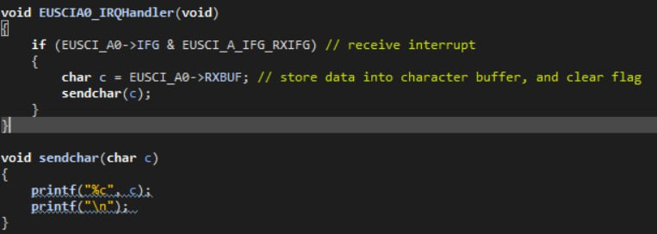
Calling Function sendchar
Printing the characters received via
EUSCI_A0->RXBUF

Slide 35
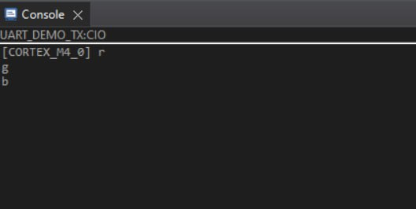
Printing the received characters

